Slide 1

>
>
SubDrop A

Slide 2
Look, there’s Elmo!
He’s gonna read with us today!

Slide 3
But sometimes he runs away for a minute.
Uh-oh!

Slide 4

Look, there’s Elmo!
And look, it’s a star!
Say, “Star!”
[Okay to repeat once if your child doesn’t answer, otherwise just go on.]

Slide 5
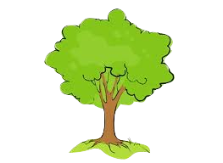
Oh! Now Elmo’s not there!
But look, it’s a tree!
Say, “Tree”

Slide 6
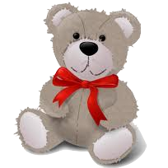
There’s Elmo!
And look, it’s a bear!
Say, “Bear”

Slide 7

Look, it’s a fire truck!
Say, “The firetruck is red!”

Slide 8
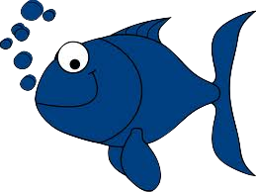
Look, now Elmo’s not here.
But here’s a fish!
And you know what?
The fish can swim!

Slide 9
Can you tell Elmo what I said before?
Say, “The fish can swim!”

Slide 10
>
Yay! Now let’s see some more!

Slide 11

There’s some bananas!

Slide 12
There’s a monkey...

Slide 13

...and there’s some oranges!

Slide 14
There they are!! Let’s see what happens...

Slide 15
Look, now Elmo’s not there!
And look at that!
The monkey is eating the orange.

Slide 16
Let’s tell Elmo what happened!
Say, “The monkey is eating the orange.”

Slide 17
>
There’s a girl!

Slide 18
>
There’s a boy!

Slide 19

...and there’s a book!

Slide 20
>
>
There they are!! Let’s see what happens...

Slide 21
>
>
Look at that!
The boy is reading the book.

Slide 22
>
>
Let’s tell Elmo what happened!
Say, “The boy is reading the book.”

Slide 23
>
There’s a grandma!

Slide 24
There’s a baby!

Slide 25

...and there’s a ball!

Slide 26
>
There they are!! Let’s see what happens...

Slide 27
>
Look at that!
The baby is rolling the ball.

Slide 28
>
Let’s tell Elmo what happened!
Say, “The baby is rolling the ball.”

Slide 29
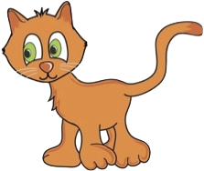
There’s a kitty cat!

Slide 30
>
There’s a girl!

Slide 31

...and there’s a doggie!

Slide 32
>
There they are!! Let’s see what happens...

Slide 33
>
Look at that!
The girl is feeding the doggie.

Slide 34
>
Let’s tell Elmo what happened!
Say, “The girl is feeding the doggie.”

Slide 35
There’s some milk!

Slide 36
>
There’s a Grandma!

Slide 37
...and there’s some juice!

Slide 38
>
>
There they are!! Let’s see what happens...

Slide 39
>
Look at that!
The grandma is drinking juice.

Slide 40
>
>
Let’s tell Elmo what happened!
Say, “The grandma is drinking juice.”

Slide 41
There’s a monkey!

Slide 42
There’s a duck!

Slide 43
...and there’s a bowl!

Slide 44
There they are!! Let’s see what happens...

Slide 45
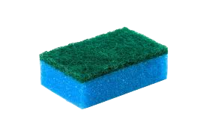
Look at that!
The duck is washing the bowl.

Slide 46
Let’s tell Elmo what happened!
Say, “The duck is washing the bowl.”

Slide 47
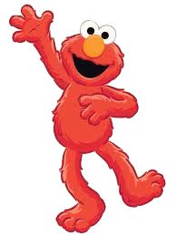
All done, yay!!

